Slide 1
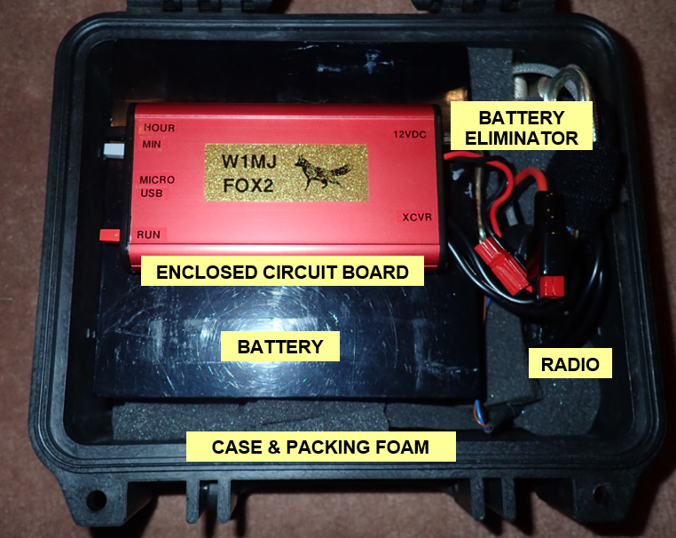
W1MJ Fox Design
Presented by Eliot Mayer, W1MJ
Waltham Amateur Radio Association
September 27, 2023
W1MJ Second-Generation Fox

Slide 2
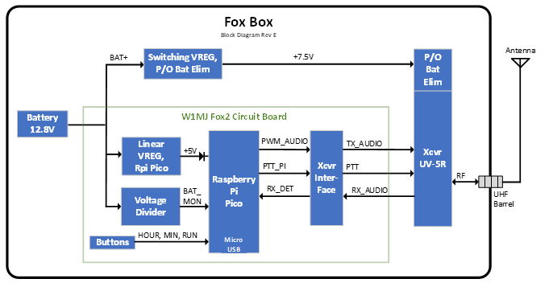
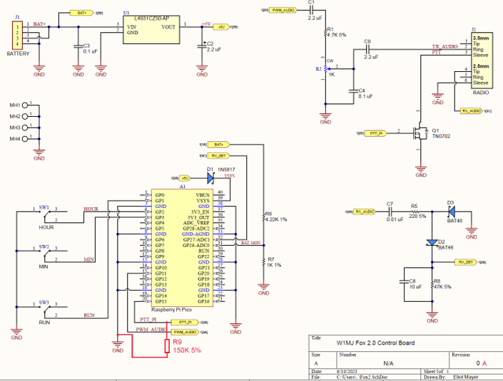
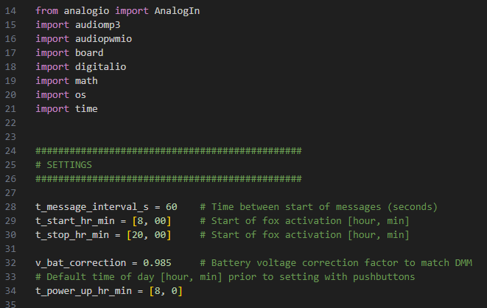
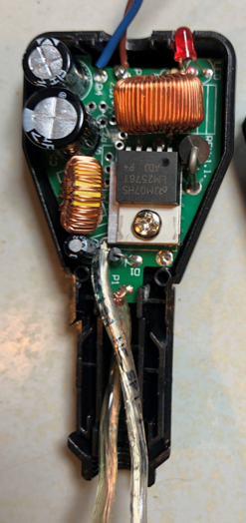
Workshop Outline
What is a Fox?
W1MJ FOX2 Design Goals
Design Overview
Fox Circuit Board Design
Software Design
Lessons Learned

Slide 3
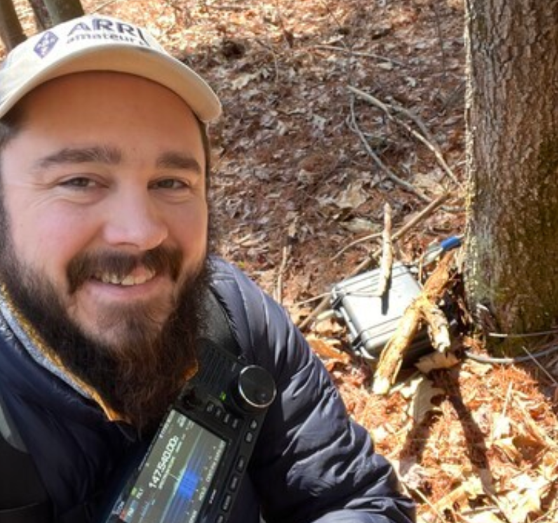
What is a Fox?
Some radio amateurs participate in hidden transmitter hunts for fun or for training, preferably both.
Hidden transmitter hunts are sometimes called fox hunts. The fox is the hidden transmitter. It could be a radio ham hiding in the woods, but these days is more frequently an automated transmitter.
Serious Fun!
K1PJW finds joy in locating W1MJ’s Fox

Slide 4
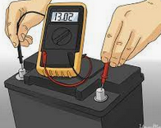
Design Goals, W1MJ FOX2
First-generation fox used an MP3 player with a very simple interface to a Baofeng radio.
Goals for second-generation fox:
Longer deployments by going to sleep at night or transmitting on demand
Announce battery voltage
Stop transmitting when battery is low

Slide 5
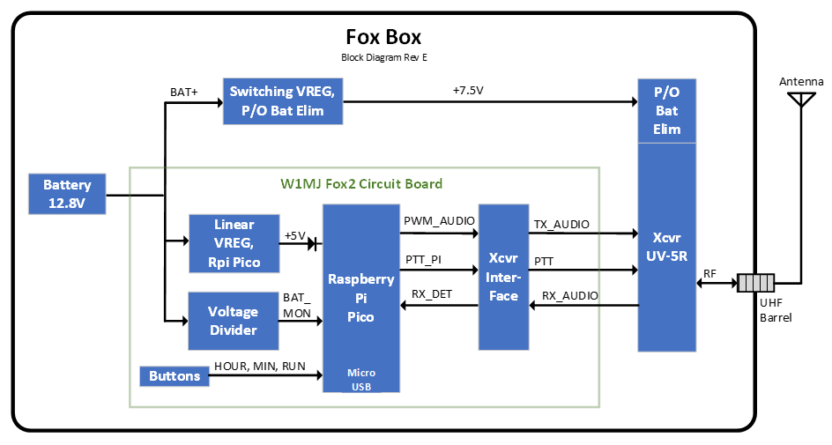
Design Overview
Block Diagram, W1MJ FOX2

Slide 6
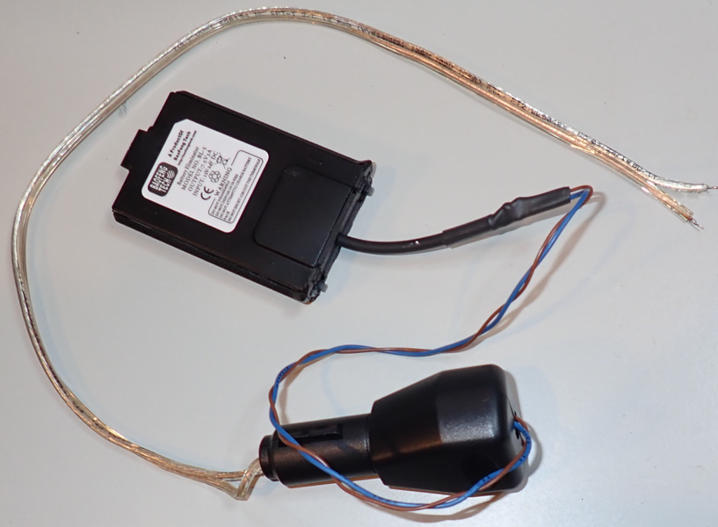
Design Overview
Main Components
Case: Pelican 1200 Black
Battery: 12.8V 30AH LiFePO4
Radio: Baofeng UV-5R
Battery Eliminator: Baofeng Tech BL-5
Circuit Board

Slide 7
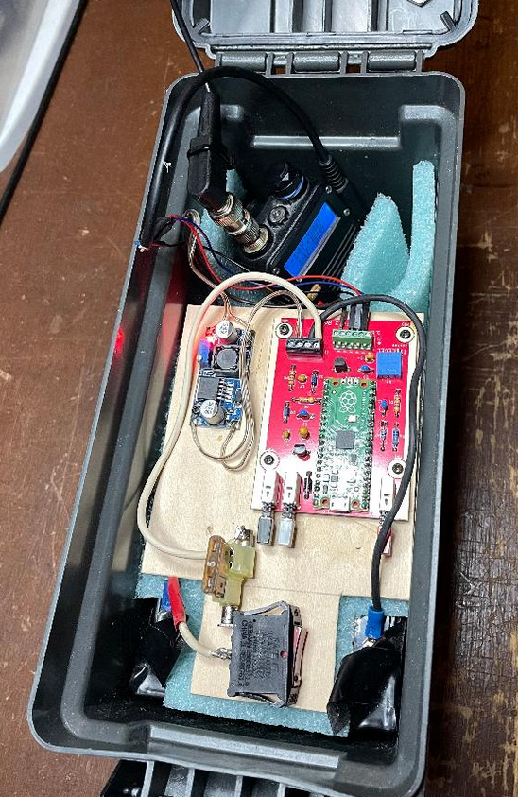
Design Overview
K1MJC’s Fox Assembly
Case: Harbor Freight 0.30 Cal Ammo Box
Has Power Switch
Has Fuse
Baofeng F8HP Radio
12V 15AH Lead Acid Battery
DZS Elec Voltage Regulator

Slide 8
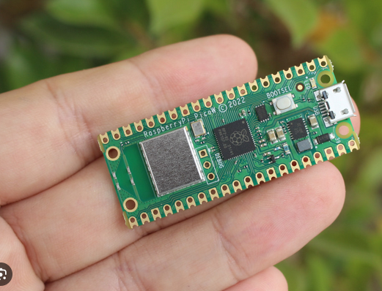
Design Overview
Why Raspberry Pi Pico?
Heard about it at a QSO Today Expo tech forum
Capable of implementing the design goals
Low power consumption: 5V x 26 mA = 130 mW
Small: 51 x 21 mm
Inexpensive: $4

Slide 9
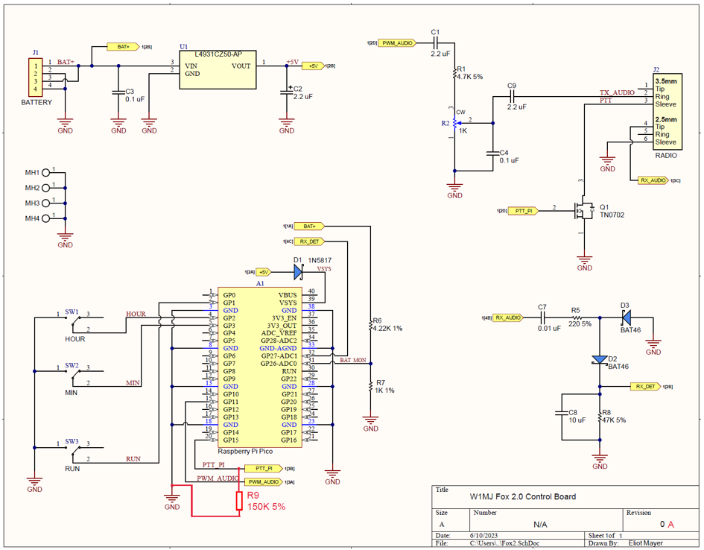
Fox Circuit Board Design

Slide 10
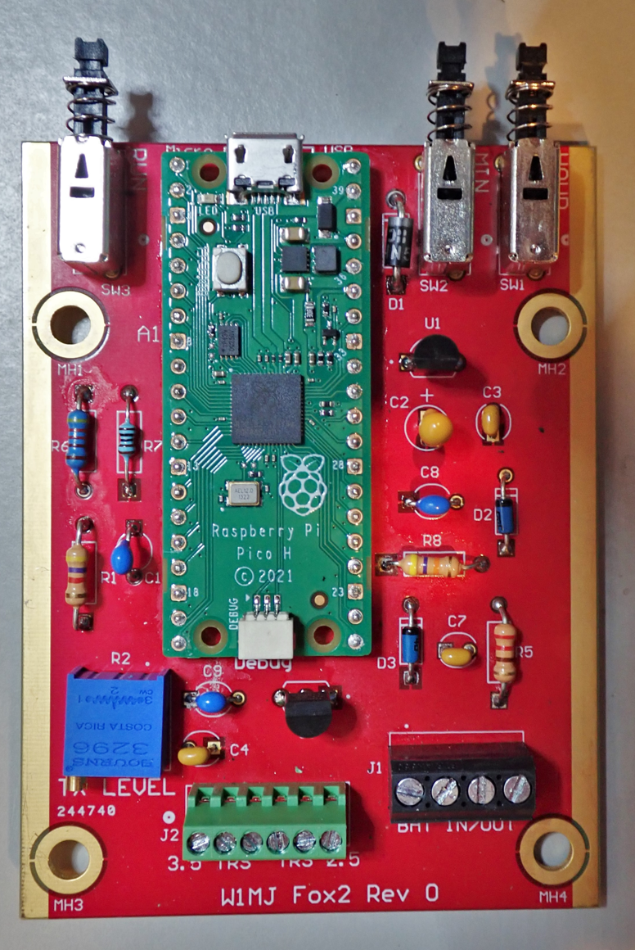
Fox Circuit Board Design
Schematic: Altium Designer
PCB Layout: Altium Designer
Fabrication: Digi-Key DKRed

Slide 11
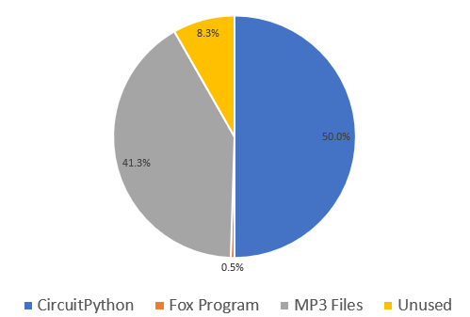
Software Design
Why CircuitPython?
Python is popular, easy to use, and free. I had taken a course.
CircuitPython has everything needed for this fox, including an MP3 decoding function.
Python is actually named after Monte Python’s Flying Circus!
20 files,
16 ksps mono
Usage of Pico’s 2MB Storage

Slide 12
Software Design
Program Outline
Import modules
Settings (message interval, start & stop times, etc)
Define Functions
Initialization
IO Port assignments
Miscellaneous initialization tasks
Set time (buttons, voice feedback via radio)
Buttons: Hour, Min (5-min increments), Run (long push for On Demand Mode)
Message Loop
During scheduled time, with OK battery voltage
Transmit all messages sequentially
Measure and transmit battery voltage
Repeat
In On Demand Mode, wait for new request

Slide 13
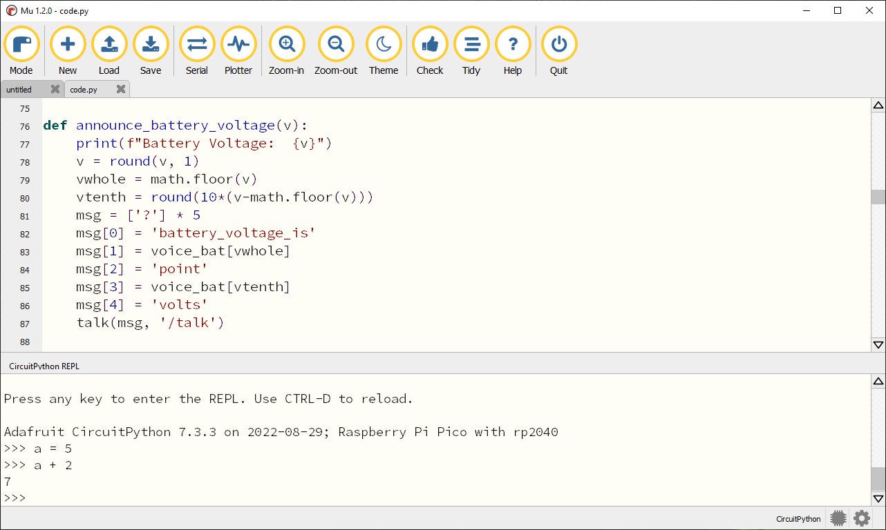
Software Design
Coding and Debugging: Mu Editor

Slide 14
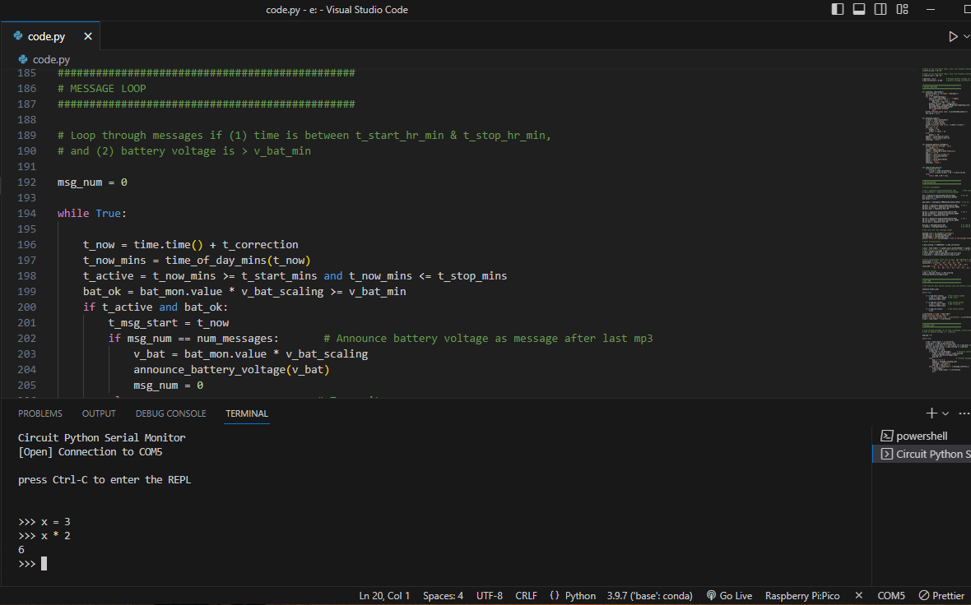
Software Design
Coding and Debugging: Visual Studio Code

Slide 15
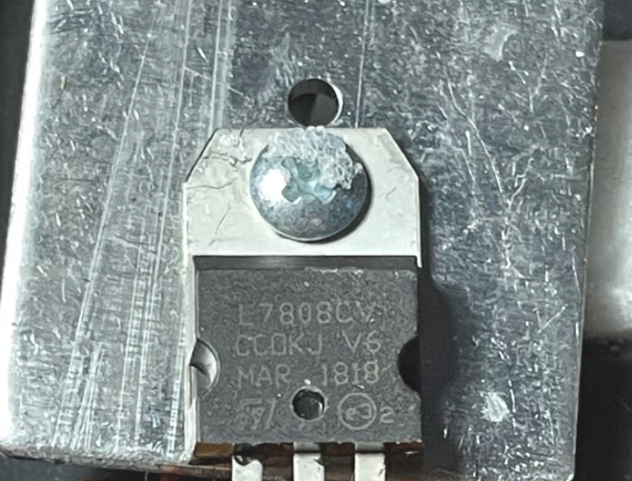
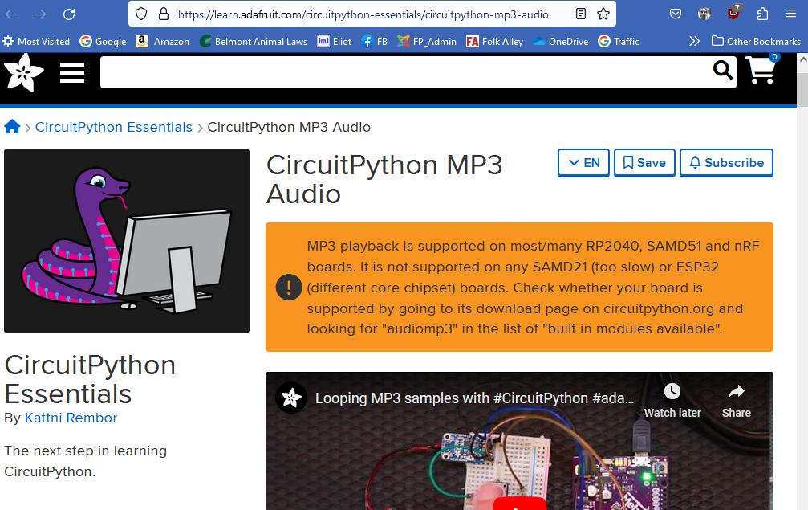
Lessons Learned
Don’t Assume
Use of AI – Caveat Emptor
Switching Regulator in Baofeng BL-5 Battery Eliminator
Linear Regulator in K1MJC’s Battery Eliminator
From OpenAI / ChatGPT
Adafruit page found with Google

Slide 16
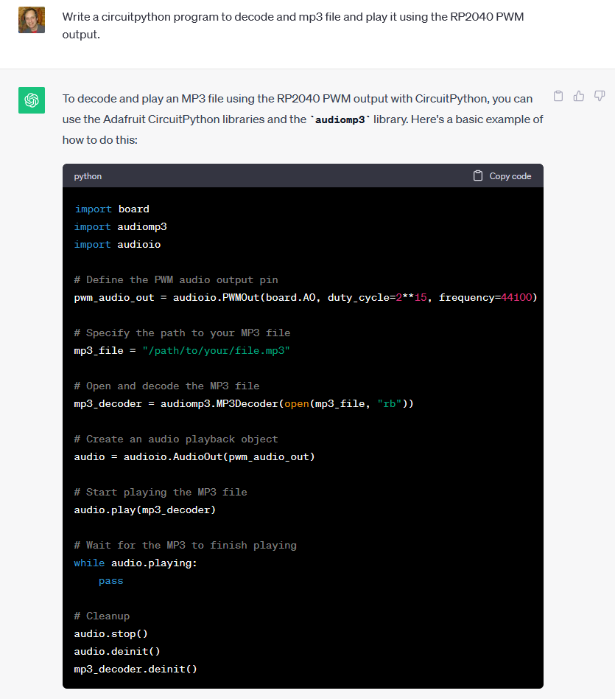
Lessons Learned
Don’t Assume
Use of AI – Caveat Emptor
Response to Reworded Question

Slide 17
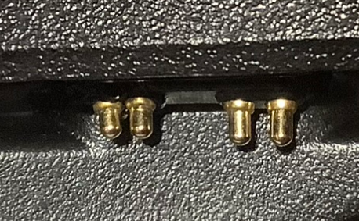
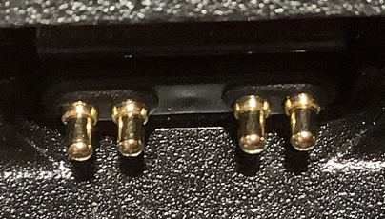
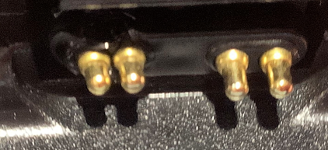
Lessons Learned
Don’t Assume
Use of AI – Caveat Emptor
It’s always something!
Original UV-5R
New UV-5R

Slide 18
Fox Hunting References
Northeast Massachusetts Fox Hunters
https://groups.io/g/NEMassFoxHunters/messages
Prospect Hill Intermod, Winter 2022
http://walthamara.org/phi/2022-winter.pdf
Google
https://www.google.com/search?q=Hidden+Transmitter+Hunting

Slide 19
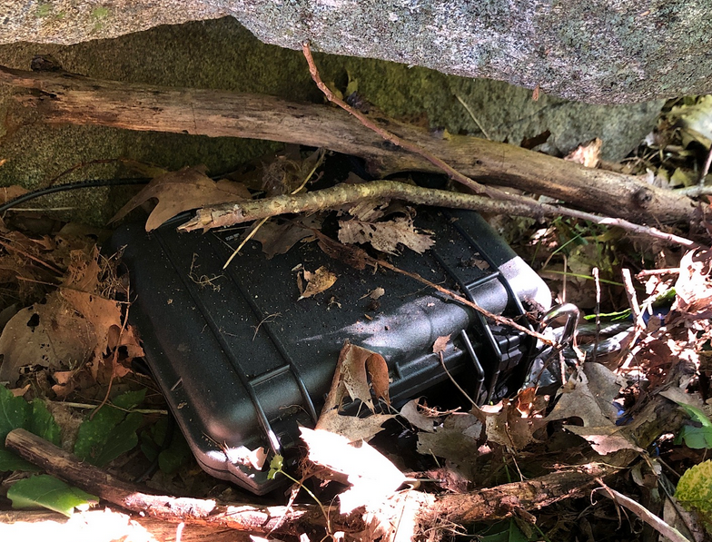
Thank You
w1mj.com/fox

